Slide 1

Customer Feedback Analysis for Amazon's Logistics Services
FISEYE SAMUEL FIDUDUSOLA
GROUP 3

Slide 2
Agenda’s
Introduction
Data Overview
Data Cleaning and Preprocessing
Sentiment Analysis Methodology
Model Evaluations
Presentation Title

Slide 3
Introduction
Welcome to our presentation on "Customer Feedback Analysis for Amazon's Logistics Services." Today, we will explore how analysing customer feedback can provide valuable insights into the performance of Amazon's logistics operations.
Amazon, founded by Jeff Bezos in 1994, has grown to become one of the world's largest e-commerce platforms, known for its commitment to customer satisfaction and efficient delivery services. With millions of customers worldwide, understanding their feedback is crucial for maintaining and enhancing the quality of logistics services.
In this analysis, we will delve into customer reviews to gauge sentiment regarding Amazon's logistics services. By leveraging data-driven insights, we aim to identify strengths and areas for improvement in the delivery experience, ultimately contributing to better service and customer satisfaction.

Slide 4

Dataset Overview
The dataset used for this analysis was sourced from Kaggle and comprises customer reviews from various regions where Amazon services are utilized. For this project, I filtered the dataset to focus specifically on North American countries, allowing for a more targeted examination of customer experiences and sentiment regarding Amazon's logistics services. With over 21,000 reviews, this dataset provides valuable insights into consumer feedback, which is essential for assessing the quality and effectiveness of Amazon’s delivery operations.

Slide 5
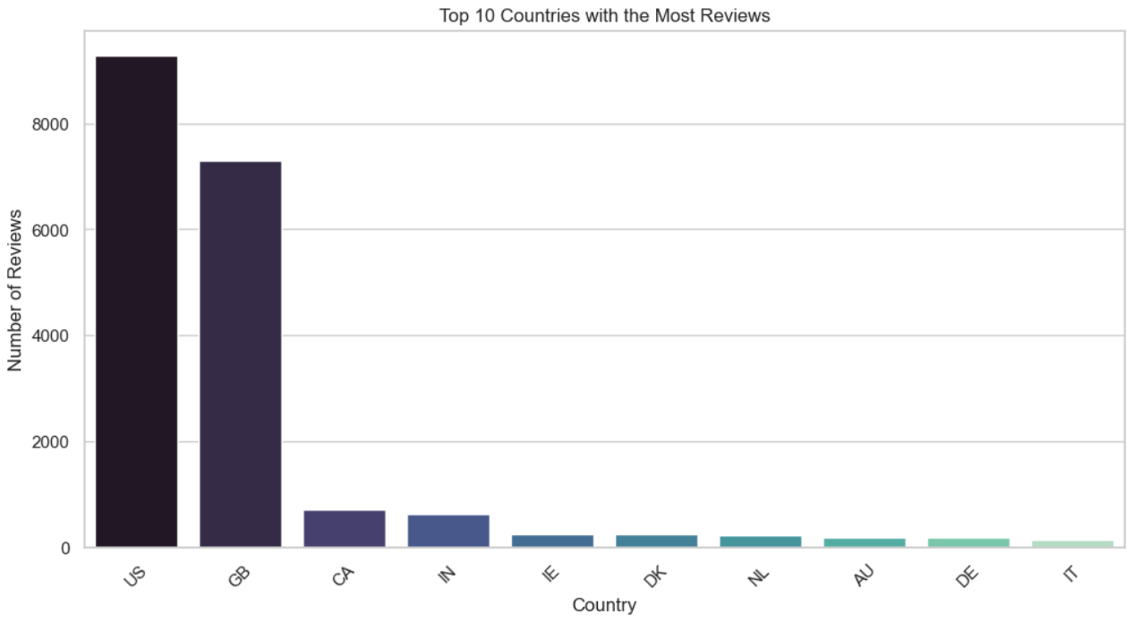
Country Distribution with the most review before transformation

Slide 6
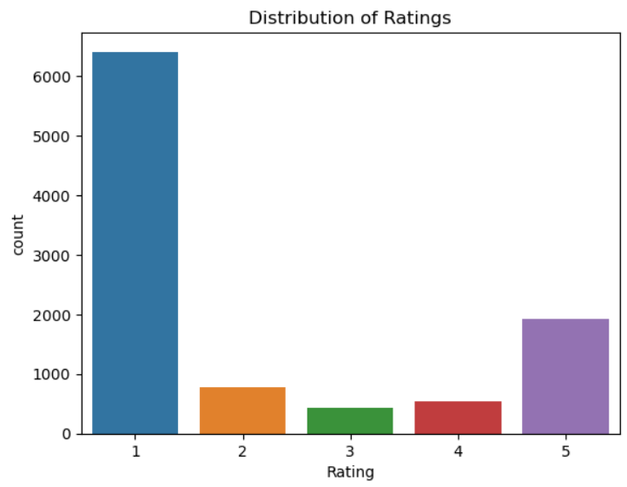
Distribution of Ratings

Slide 7
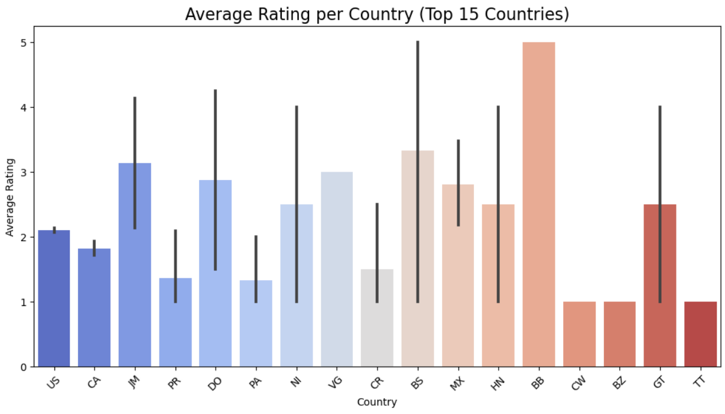
Average Rating per Country

Slide 8
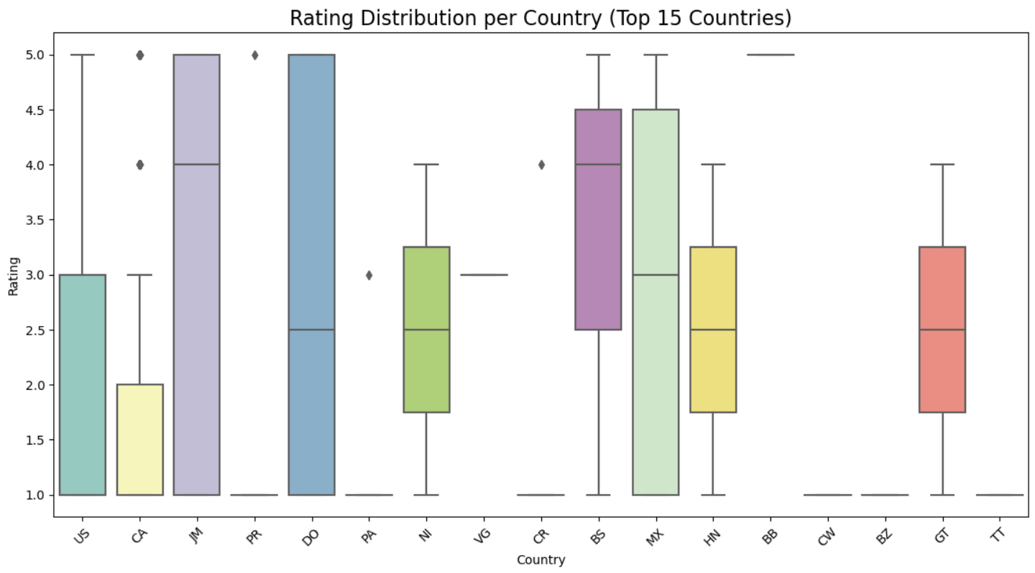
Rating Distribution per Country (Box Plot)

Slide 9
Data Cleaning and Preprocessing
ETL Process
Extract
The CSV file included reviews across various regions and contained fields like Country, Review Date, Rating, Review Title, and Review Text
Transform
Duplicate Removal: Removed any redundant records to avoid skewing the analysis.
Handling Missing Values: Addressed gaps in the data by applying appropriate techniques like filling with default values or dropping incomplete records.
Text Preprocessing: For the textual reviews, we performed the following:
Tokenization
Stopword Removal
Standardization: Ensured consistency in data formatting, particularly for dates and numerical values.
Load
The transformed, clean data was loaded into a PostgreSQL database.

Slide 10
Sentiment Analysis Model
Model Selection
Multinomial Naive Bayes and Logistic Regression were chosen due to their high performance in text classification tasks.
Multinomial Naive Bayes is fast and efficient for text data. Logistic Regression offers robust performance and interpretable outputs.
Preprocessing
Vectorization: Using CountVectorizer, the textual data was converted into numerical form based on word frequency, enabling the models to process and classify the reviews.
Data Balancing (SMOTE): Techniques such as oversampling or undersampling were applied to ensure the dataset was balanced, allowing the models to avoid bias and provide more accurate predictions.
Training and Testing
The dataset was split into training (to teach the model) and testing sets (to validate the model's performance).

Slide 11
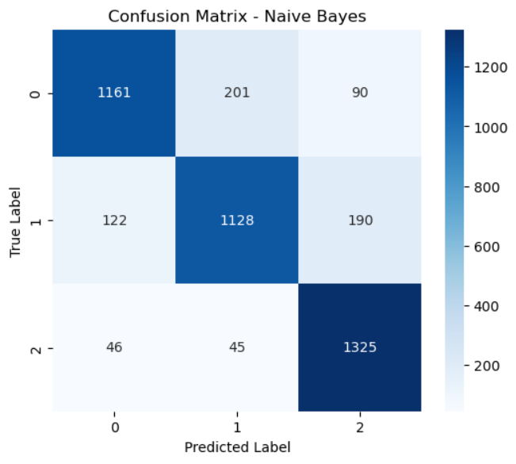
Model Evaluation
MULTINOMIAL NAÏVE BAYES EVALUATION
Accuracy: 0.8389
Precision: 0.8402
F1-Score: 0.8377

Slide 12
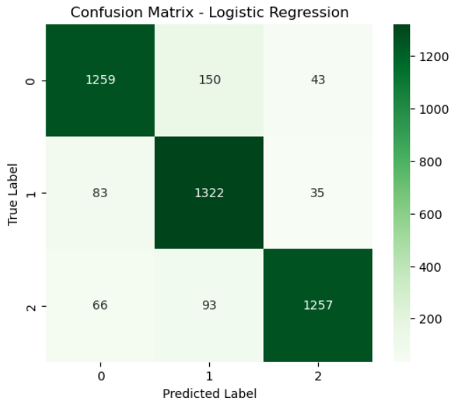
Model Evaluation
LOGISTICS REGRESSION EVALUATION
Accuracy: 0.8909
Precision: 0.8932
F1-Score: 0.8912

Slide 13


Summary
The sentiment analysis models performed well in classifying Amazon customer reviews, with Logistic Regression outperforming Multinomial Naive Bayes across most metrics.
Logistic Regression achieved a higher accuracy of 89.09% and demonstrated stronger precision (89.32%) and F1-Score (89.12%). Its confusion matrix showed fewer misclassifications, with a relatively low number of false positives and false negatives, indicating more consistent performance across all categories.
Multinomial Naive Bayes had an accuracy of 83.89% and a precision of 84.02%. Its confusion matrix revealed more misclassifications, particularly with higher false negatives, where some positive or neutral reviews were incorrectly classified.
In conclusion, while both models performed well, Logistic Regression proved to be more reliable in correctly classifying the reviews, with fewer misclassifications, making it the better option for this dataset.

Slide 14





Thank you

